Slide 1
Object-Oriented Programming (OOPs) - Part I

Slide 2
What is OOPS?
Object-Oriented Programming System (OOPs) is a programming concept that works on the principles of abstraction, encapsulation, inheritance, and polymorphism. It allows users to create objects they want and create methods to handle those objects. The basic concept of OOPs is to create objects, re-use them throughout the program, and manipulate these objects to get results.
OOP meaning “Object Oriented Programming” is a popularly known and widely used concept in modern programming languages like Java

Slide 3
Advantages of OOPs
OOPs Concepts in Java offer easy to understand and a clear modular structure for programs.
Objects created for Object-Oriented Programs can be reused in other programs. Thus it saves significant development cost.
Large programs are difficult to write, but if the development and designing team follow OOPS concepts, then they can better design with minimum flaws.
It enhances program modularity because every object exists independently.

Slide 4
List of OOPs Concepts
Class
Object
Inheritance
Polymorphism
Abstraction
Encapsulation
Association
Aggregation
Composition

Slide 5
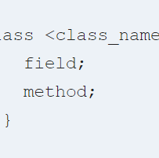
What is Class in Java?
Class are a blueprint or a set of instructions to build a specific type of object. It is a basic concept of Object-Oriented Programming which revolve around the real-life entities. Class in Java determines how an object will behave and what the object will contain.

Slide 6

What is Object in Java?
Object is an instance of a class. An object in OOPS is nothing but a self-contained component which consists of methods and properties to make a particular type of data useful. For example color name, table, bag, barking. When you send a message to an object, you are asking the object to invoke or execute one of its methods as defined in the class.

Slide 7
Difference Between Object and Class in Java?
A Class in object oriented programming is a blueprint or prototype that defines the variables and the methods (functions) common to all Java Objects of a certain kind.
An object in OOPS is a specimen of a class. Software objects are often used to model real-world objects you find in everyday life.

Slide 8
Ways to create objects in Java
Java is an object-oriented language, everything revolve around the object. An object represents runtime entity of a class and is essential to call variables and methods of the class.
New keyword
New instance
Clone method
Deserialization
NewInstance() method

Slide 9
You can design any program using this OOPs approach
While creating a class, one must follow the following principles.
Single Responsibility Principle (SRP)- A class should have only one reason to change
Open Closed Responsibility (OCP)- It should be able to extend any classes without modifying it
Liskov Substitution Responsibility (LSR)- Derived classes must be substitutable for their base classes
Dependency Inversion Principle (DIP)- Depend on abstraction and not on concretions
Interface Segregation Principle (ISP)- Prepare fine grained interfaces that are client specific.

Slide 10
Classes and Objects in Java Example

Slide 11
Java Object and Class Example: main outside class

Slide 12

Constructor
A constructor is a special method that is used to initialize an object. Every class has a constructor either implicitly or explicitly.
If we don't declare a constructor in the class then JVM builds a default constructor for that class. This is known as default constructor.
A constructor has same name as the class name in which it is declared. Constructor must have no explicit return type. Constructor in Java can not be abstract, static, final or synchronized. These modifiers are not allowed for constructor.

Slide 13
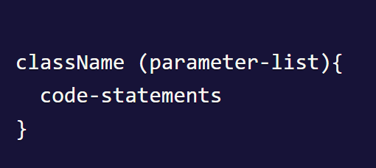
Constructor(Contd…)
className is the name of class, as constructor name is same as class name.
parameter-list is optional, because constructors can be parameterize and non-parameterize as well.

Slide 14

Constructor Example

Slide 15
Types of Constructor
Java Supports two types of constructors:
Default Constructor
Parameterized constructor
Each time a new object is created at least one constructor will be invoked

Slide 16

Default Constructor
n Java, a constructor is said to be default constructor if it does not have any parameter. Default constructor can be either user defined or provided by JVM.
If a class contain a constructor with no parameter then it is known as default constructor defined by user. In this case JVM does not create default constructor.
The purpose of creating constructor is to initialize states of an object.

Slide 17
Constructor Overloading
Constructor overloading you have multiple constructor with different signature but only difference is that constructor doesn't have return type.

Slide 18

Constructor Chaining
Constructor chaining is a process of calling one constructor from another constructor in the same class. Since constructor can only be called from another constructor, constructor chaining is used for this purpose.
To call constructor from another constructor this keyword is used. This keyword is used to refer current object.

Slide 19

Private Constructors
In Java, we can create private constructor to prevent class being instantiate. It means by declaring a private constructor, it restricts to create object of that class.
Private constructors are used to create singleton class. A class which can have only single object known as singleton class.

Slide 20
Access Modifiers in Java
Access modifiers are keywords in Java that are used to set accessibility. An access modifier restricts the access of a class, constructor, data member and method in another class.
Java language has four access modifier to control access level for classes and its members.
Default: Default has scope only inside the same package
Public: Public has scope that is visible everywhere
Protected: Protected has scope within the package and all sub classes
Private: Private has scope only within the classes.

Slide 21
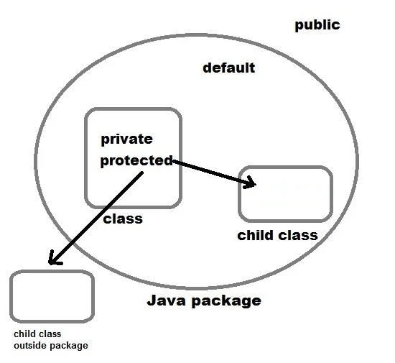
Access Modifiers in Java

Slide 22
Non-access Modifier
Along with access modifiers, Java provides non-access modifiers as well. These modifier are used to set special properties to the variable or method.
Non-access modifiers do not change the accessibility of variable or method, but they provide special properties to them. Java provides following non-access modifiers.
Final
Static
Transient
Synchronized
Volatile

Slide 23
Inheritance in Java OOPs
Inheritance is a mechanism in which one class acquires the property of another class. For example, a child inherits the traits of his/her parents.
With inheritance, we can reuse the fields and methods of the existing class.
Hence, inheritance facilitates Reusability and is an important concept of OOPs.

Slide 24
Java this keyword
In Java, this is a keyword which is used to refer current object of a class. we can it to refer any member of the class. It means we can access any instance variable and method by using this keyword.
The main purpose of using this keyword is to solve the confusion when we have same variable name for instance and local variables.
We can use this keyword for the following purpose.
this keyword is used to refer to current object.
this is always a reference to the object on which method was invoked.
this can be used to invoke current class constructor.
this can be passed as an argument to another method.

Slide 25
Calling Constructor using this keyword
Accessing Method using this keyword
Return Current Object from a Method

Slide 26
Static in Java
Static is a keyword in Java which is used to declare static stuffs.
It can be used to create variable, method block or a class.
Static variable or method can be accessed without instance of a class because it belongs to class.
Static members are common for all the instances of the class, but non-static members are different for each instance of the class. Let's study how it works with variables and methods.

Slide 27
Static in Java
Static Variables
Static Method in Java
Static block in Java
Non-static (instance) variable cannot be referenced from a static context.

Slide 28
Static variables
Static variables defined as a class member can be accessed without object of that class.
Static variable is initialized once and shared among different objects of the class.
All the object of the class having static variable will have the same instance of static variable.
Note: Static variable is used to represent common property of a class. It saves memory.

Slide 29
Static vs. Instance
Static variable | Instance Variable
Represent common property | Represent unique property
Accessed using class name (can be accessed using object name as well) | Accessed using object
Allocated memory only once | Allocated new memory each time a new object is created

Slide 30
Static Method in Java
A method can also be declared as static. Static methods do not need instance of its class for being accessed.
main() method is the most common example of static method.
main() method is declared as static because it is called before any object of the class is created.

Slide 31
Static block in Java
Static block is used to initialize static data members. Static block executes even before main() method.
It executes when the class is loaded in the memory. A class can have multiple Static blocks, which will execute in the same sequence in which they are programmed.

Slide 32
When we try to access a non-static variable from a static context like main method, java compiler throws an error message a non-static variable cannot be referenced from a static context.
This is because non-static variables are related with instance of class(object) and they get created when instance of a class is created by using new operator.
So, if we try to access a non-static variable without any instance, compiler will complain because those variables are not yet created, and they don't have any existence until an instance is created and associated with it.

Slide 33
Why main() method is static in java?
Because static methods can be called without any instance of a class and main() is called before any instance of a class is created.

Slide 34

Java Final Modifier

Slide 35
Final
Final modifier is used to declare a field as final. It can be used with variable, method or a class.
If we declare a variable as final then it prevents its content from being modified. The variable acts like a constant. Final field must be initialized when it is declared.
If we declare a method as final then it prevents it from being overridden.
If we declare a class as final the it prevents from being inherited. We can not inherit final class in Java.

Slide 36
Java instanceof Operator and Downcasting
In Java, instanceof is an operator which is used to check object reference.
It checks whether the reference of an object belongs to the provided type or not.
It returns either true or false, if an object reference is of specified type then it return true otherwise false.
We can use instanceof operator to check whether an object reference belongs to parent class, child class, or an interface.
It's also known as type comparison operator because it compares the instance with type.

Slide 37
Downcasting in Java
Downcasting is one of the advantages of using instanceof operator.
Downcasting is a process to hold object of parent class in child class reference object.
It is reverse of upcasting, in which object of child is assigned to parent class reference object.
However, we can perform downcasting using typecasting but it throws ClassCastException at run-time.
So to avoid this we use instanceof operator to perform downcasting.

Slide 38
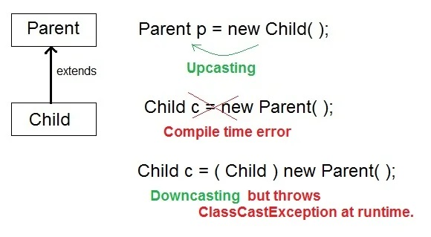
Downcasting

